Slide 1
jQuery Plugin
A Plugin is just a method that extends the jQuery objects prototype
Enabling all jQuery objects to use this method
Once a plugin is imported, it is used as regular jQuery method
Like addClass(), fadeout() and hide()

Slide 2
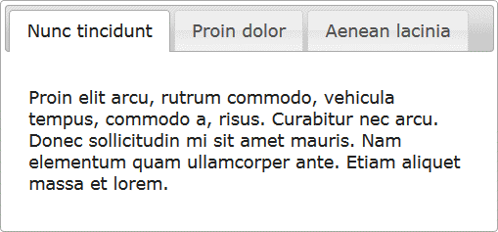
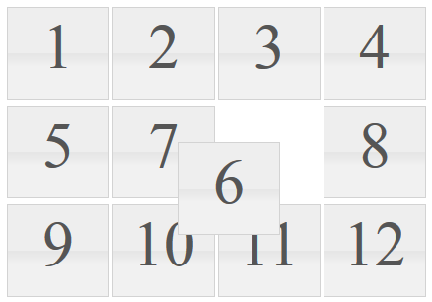
jQuery Plugins
jQuery has many ready-to-use plugins
A library jQueryUI for UI controls
Plugins for UI
Tabs
Arrangeable elements
$("#tabs-holder").tabs();
$("#grid" ).sortable();

Slide 3
Creating jQuery Plugins
jQuery has an easy way to extend the initial functionality with plugins
Just create a regular JavaScript method and attach it to jQuery.fn object
(function($){
$.fn.zoom = function(){
var $this = $(this);
$this.on("mouseover", function() {
//zoom in element
});
$this.on("mouseout", function() {
//zoom out element
});
}
}(jQuery));
$(".image").zoom();

Slide 4
Chaining in Plugins
Chaining is pretty good and useful feature
Better to be implemented in our plugins
Done easy, just return this at the end of the plugin function
(function($){
$.fn.zoom = function(){
var $this = $(this);
$this.on('mouseover', function() {…});
$this.on('mouseout', function() {…});
return $this;
}
}(jQuery));
$('.image')
.zoom()
.addClass('zoom');

Slide 5
Plugins with Options
Plugins can also be provided with options
Just pass regular function parameters
(function($){
//zoom with size percents
$.fn.zoom = function(size){
var $this = $(this);
$this.on('mouseover', function() {…});
$this.on('mouseout', function() {…});
return $this;
}
}(jQuery));

Slide 6
Plugins Options
Yet the options sometimes become too many
When too many arguments, just use a options object
Give the options as a JSON-like object

Slide 7
Homework
Create a jQuery plugin for creating dropdown list
By given the following:
<select id="dropdown">
<option value="1">One</option>
<option value="2">Two</option>
</select>
$('#dropdown').dropdown()
Produces the following HTML:
<select id="dropdown" style="display: none">…</select>
<div class="dropdown-list-container">
<ul class="dropdown-list-options">
<li class="dropdown-list-option" data-value="0">One</li>
…
</ul>
</div>
And make it work as SELECT node
Selecting an one of the generated LI nodes, selects the corresponding OPTION node
So $('#dropdown:selected') works

Slide 8
Homework (2)
*Create a jQuery plugin for fading in/fading out message box
Creates a message box
Show a success/error message in the box
Showing is done by setting the opacity of the message from 0 to 1 in an interval of 1 second
The message disappears after 3 seconds
var msgBox = $('#message-box').messageBox();
msgBox.success('Success message');
msgBox.error('Error message');

